Slide 1

Zona Del Silencio
A smart system to reduce traffic noise
Mrs. S. S. Ambarkar | Guide
Sanket Munot
Shravani Dasari
Utkarsha Kandale
Rupam Pusdekar
TEAM

Slide 2
PROBLEM STATEMENT
Sound/Noise pollution is one of the most severe problem in metropolitan area with a thriving population and traffic. The problem can be further amplified in “Silent Zones” - such as for students in schools or patients in hospitals.

Slide 3
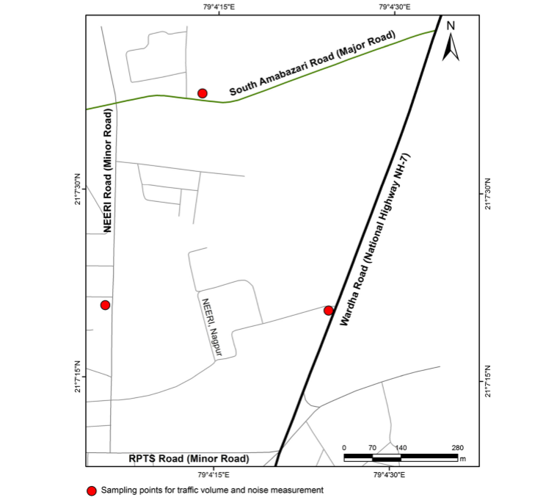
LITERATURE SURVEY
The study area comprises of three main roads namely Wardha road, SouthAmbazari road and NEERI road. These are classified as national highway, major and minor roads respectively. Road details including geometry, category, number of traffic lanes and road conditions are considered in the study. The width of national highway, major and minor roads is 21 m, 15 m and 7 m respectively. Road conditions were almost same for all roads. [1]

Slide 4
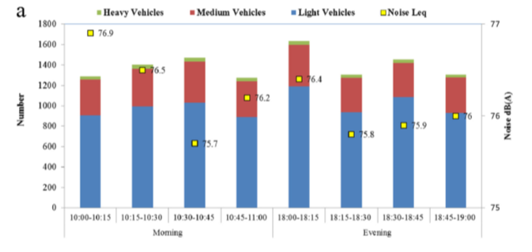
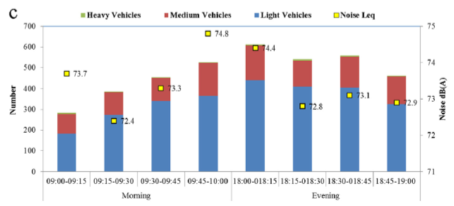
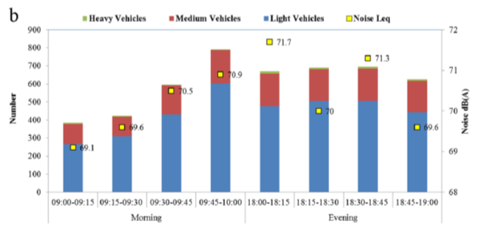

Slide 5


BACKGROUND OF PROJECT
The Library Noise Detector with Short Information Provider is a portable device that is used in detecting noise in the library. The device is used to control excessive noise inside the library. [2]
NIROB - A Device that detects overall sound level using sound sensors and displays it on the Digital Board creating an awareness among the public. [3]

Slide 6
SOLUTION
The solution to this increasing problem, “Zona del Silencio” is a device which will be connected to the vehicle, upon entering the no-honking-zones the device will suppress honking of vehicles by drivers.
The major target for our device are two wheeler light vehicle.

Slide 7
METHODOLOGY
Once the vehicle enters in silent zone, device gets connected with nearby WiFi Router. Thus, disabling the horn.
In case of an emergency, driver is provided with switch to use horn.
The count of this action is recorded at Database.
If notorious use of emergency switch is found, the user can be penalised.

Slide 8
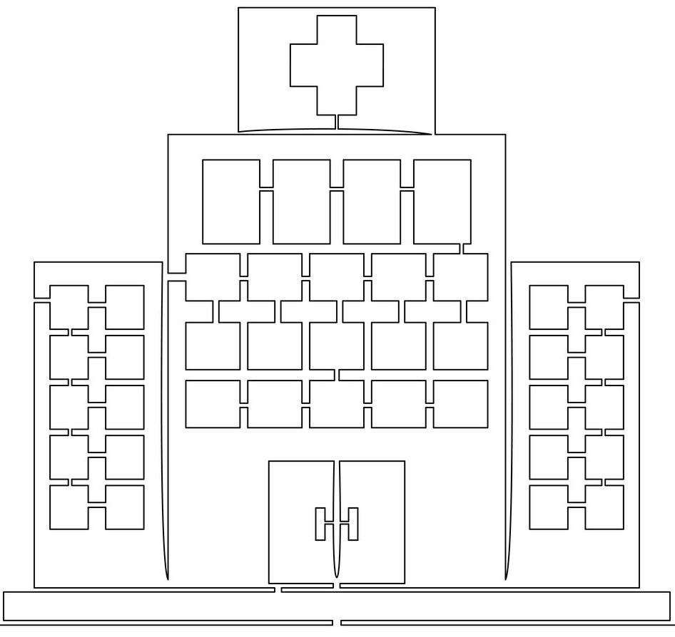



Silent Zone

Slide 9

Silent Zone

Slide 10
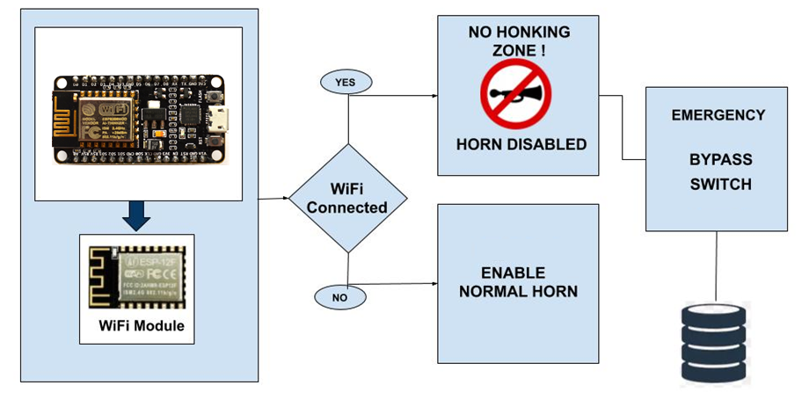
PROPOSED ARCHITECTURE

Slide 11
IMPLEMENTATION
Node MCU is provided with a program which tries to connect to Wifi infinitely.
On a successful connection input from normal switch is disabled.
The input from normal switch is enabled upon exiting the Wi-Fi zone.
A secondary switch is used as emergency button in silent zone.
An infrared sensor is used to detect vehicles ahead, if no vehicle is detected a count is increased in database to penalise.

Slide 12
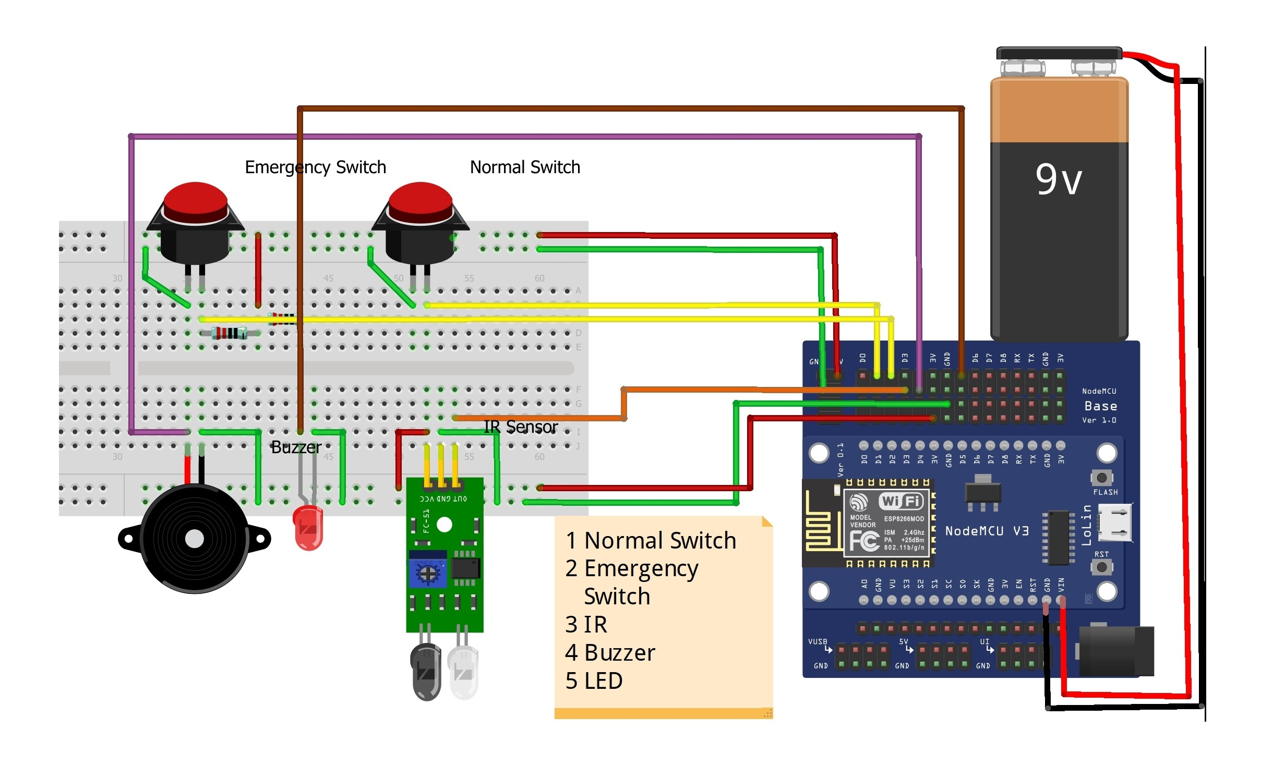
Circuit Diagram

Slide 13
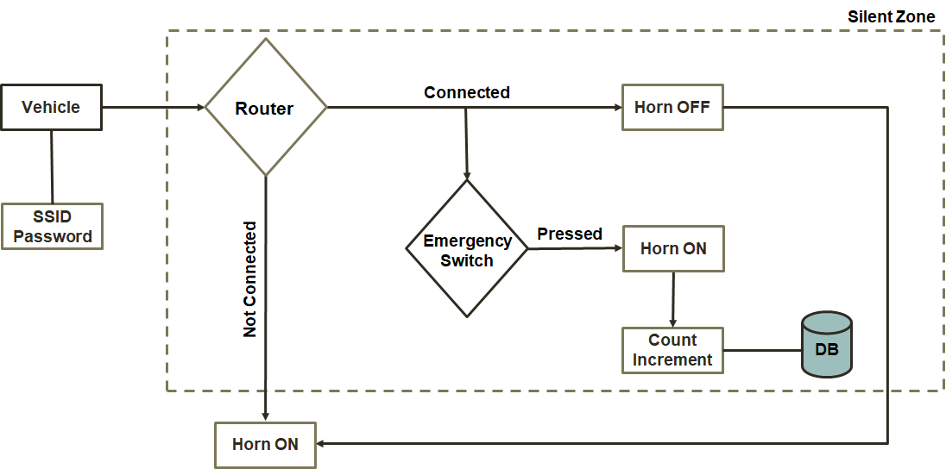
Data Flow Diagram

Slide 14
SYSTEM REQUIREMENTS
Node MCU Microcontroller
Wi-Fi Router
IR Sensor
PHP
MySQL
Misc. Hardware
COSTING
535 ₹

Slide 15
FUTURE SCOPE
Add IR sensor in all directions to detect surrounding activity.
Populate a clean dataset for future pattern recognition for betterment in penalty system.
Integration of Zona Del Silencio with RTO.

Slide 16
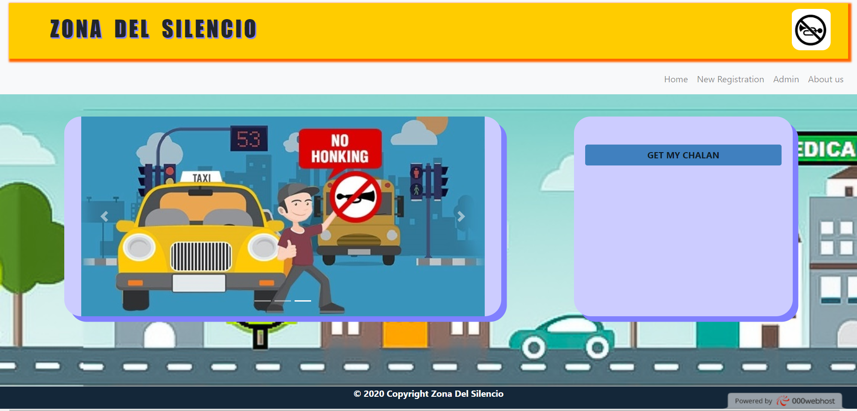
SNAPSHOTS – WEB INTERFACE

Slide 17
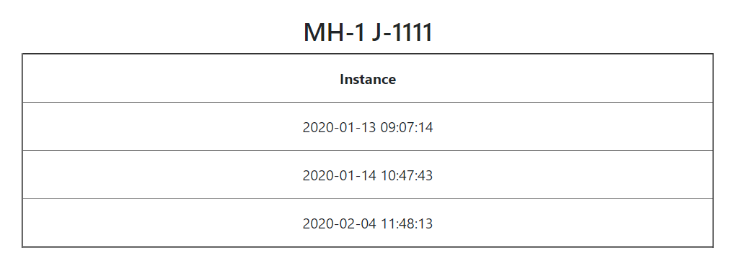
SNAPSHOT – MISUSE RECORD

Slide 18
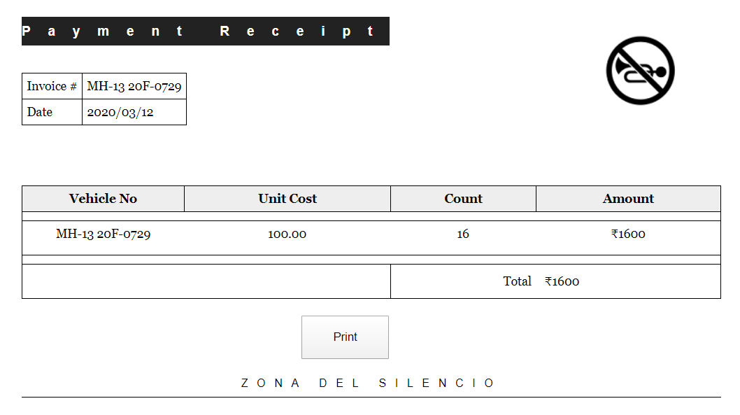

Slide 19
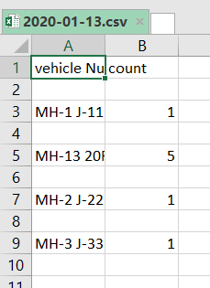
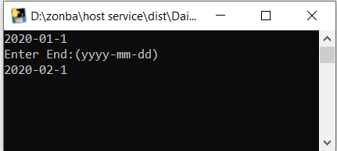
SNAPSHOT – REPORT GENERATOR

Slide 20
OUTCOME
The true silent zones would be found !

Slide 21
REFERENCES
[1] Vijay, Ritesh & Sharma, Asheesh & Chakrabarti, Tapan & Gupta, Rajesh. (2015). Assessment of honking impact on traffic noise in urban traffic environment of Nagpur, India. Journal of Environmental Health Science and Engineering. 13. 10.1186/s40201-015-0164-4.
[2] David, Nathan & V, Anyika & IfeyinwaN, Ejindu & AyodejiO, Abioye. (2013). LIBRARY SOUND LEVEL METER. Quest Journal of Electronics and Communication Engineering Research(JECER). 1. 20-29.
[3] Sojol, Jafrul & Shihab, Hashmi & Ahamed, Tanvir & Abu, Sayed & Siam, & Siddique, Shahnewaz. (2019). Nirob: A Next Generation Green Earth Technology Based Innovative System for Metropolitan Sound Pollution Management. 10.23919/ICACT.2019.8701955.

Slide 22
THANKYOU

